Slide 1
OpenShift Overview
Sudharshan Govindan
sudharshan.govindan@in.ibm.com
@sudhargovindan

Slide 2

Open Source
Notes:
The concept behind Docker containers and the widespread industry interest is not a new idea. The ability to isolate a process from other processes and their use of resources on a common kernel and hardware has been evolving since choot provided a way to implement file space isolation with unix in the '80s.
This evolved to bring more features over time, in early 2000's there were FreeBSD jails, and also user-space virtualization solutions, open source and proprietary products
Solaris Containers and LXC were quite feature-rich, providing just about everything needed for an os-virtualization solution.
Because container systems did not require multiple operating system installations and hypervisors, they have had an edge in efficiency over vms. But VM's which also matured over the same period grabbed major mindshare and use as IT developed consolidation models and grew into Cloud
Docker containers have risen in popularity and use with developers because of the ecosystem approach in combination with platform support for development workstations... Can get Docker engine for MacOSX, Windows, Linux platforms and it runs across server platforms even Linux on IBM 390/system Z

Slide 3
What are Containers (not Docker)?
Similar to VMs but managed at the process level
"VM-like” isolated achieved by set of "namespaces" (isolated view)
PID –isolated view of process IDs
USER- user and group IDs
UTS - hostname and domain name
NS - mount points
NET - Network devices, stacks, ports
IPC - inter-process communications, message queues
cgroups - controls limits and monitoring of resources
The key statement: A container is a process(es) running in isolation
Notes:
VMs isolate at the Operating System level. Multiple independent OS, vs one OS with multiple independent processes.
VM running in isolation - full-blown operating system
Container - run just the processes that you need to get your business function done
- example: tomcat processes -
Container uses namespaces - provides its own view of the world in terms of….
- elaborate on PID namespace as an example. PIDS don’t match host or other containers. Mapped to host.
- namespaces includes all key aspects of a VM
- root file system for each container, means containers get its own view of a file system
CGroups
- limit number of resources so that one container doesn’t take over the machine
Namespaces and protecting
- Access to host? can do anything
- container security is about preventing from hackers from “Escaping the containers”
- users do not have access to the host

Slide 4
VM vs Container
Virtual Machine
Container
Virtual Machine
Container
Virtual Machine
Container
App
App
App
bins / libs
bins / libs
Operating System +procs
VS
OS-specific files
<-Emulates a full OS
Hypervisor
Base OS/Kernel
<- Actual OS
VM ?
Hardware
Hardware
Each VM has its own OS
Containers share the same base Kernel

Slide 5
What is Docker?
Containers is the technology, Docker is the tooling around containers
Without Docker, containers would be unusable (for most people)
Docker simplified container technology to enable it for the masses
Added value: Lifecycle support, setup file system, etc
For extra confusion: Docker is also a company, which is different then Docker the technology…

Slide 6
Docker Images
Tar file containing a container's filesystem + metadata
For sharing and redistribution
Global/public registry for sharing: DockerHub
Docker Host
Containers
Containers
Images
Ubuntu
Liberty
Docker Engine
Base OS/Kernel

Slide 7
Docker Registry
The central place to share images with friends! (or coworkers)
DockerHub - http://hub.docker.com
Public registry of Docker Images
Also useful to find prebuilt images for web servers, databases, etc
Enterprises will want to find a private registry to use (such as one built into ICP)
Docker Host
Containers
Containers
Registry
Images
Ubuntu
Liberty
Ubuntu
Liberty
nginx
mysql
Docker Engine
Base OS/Kernel

Slide 8
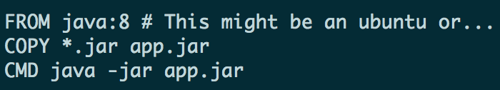
Build your own image with a Dockerfile!
Step 1) Create Dockerfile to script how you want the image to be built
Step 2) docker build to build an image
Step 3) docker push to push to registry
Step 4) From another location, docker pull to download an image
Layer
Layer
Layer
Notes:
Docker. Not a new technology
Containers have been around for a while (IBM helped invent it)
Docker created a tool for the masses
- tool on top of containers
- containers does not mean docker (other providers out there)
- docker implemented tooling very well

Slide 9
Shared / Layered / Union Filesystems
Read-only image layers are shared via Union File System and copy-on-write
At Build Time
Layers are built on top of each other
Layers that are already built, are not re-built
Layers that are already pushed, are not re-pushed
At Run Time
Containers based off the same image reuse the same layers
Many containers from the same image, just create the top layer.
CNTR1
CNTR2
CNTR3
CNTR4
Layer
app1
app2
app3
app4
Layer
tomcat
liberty
tomcat
Layer
Fedora
Ubuntu
Base OS / Kernel
Filesystem

Slide 10
In a Traditional Deployment…
Are you testing these on ever commit?
Code (packages archive)
App server
Runtime versions
System libraries and versions
Notes:
Windows Containers available in Windows Server 2016 Tech Previews, and on Windows 10 Insider Track
“multi-architecture image” docker hub will pull the correct version
people have to go out of their way to build these images
pull x86 image, will it run on Power or Z? probably not
which images are for Power or Z? can’t tell on docker hub
create namespace to identify different architecture support

Slide 11
Container = Code + Dependencies
Code (packages archive)
App server
Runtime versions
System libraries and versions

Slide 12
Dependency Matrix from Hell
Notes:
How do we apply security consistently too all of these different environments?

Slide 13
Halfway up the stack
Notes:
standard interface for operations will come in handy when trying to solve problems like providing external configuration, and generic operations concerns such as scheduling applications, scaling etc.
it also a measure of portability. applications are self-contained. no dependencies on underlying infrastructure. run on any platform, on-prem cloud, doesn’t matter. Only requirement is linux or windows, and the docker engine installed

Slide 14
What is container orchestration?
For a distributed set of nodes:
Scheduling
Service discovery
Scaling up/down
Health management
Manage cluster resources
Manager
Image Repository
Scheduler
Discovery DB
Replicator
Node
Node
Node
Daemon
Daemon
Daemon
Containers
Containers
Containers
© Copyright IBM Corporation 2017

Slide 15
Kubernetes Architecture
At its core, Kubernetes is a database (etcd). With "watchers" & "controllers" that react to changes in the DB. The controllers are what make it Kubernetes. This pluggability and extensibility is part of its "secret sauce".
DB represents the user's desired state
Watchers attempt to make reality match the desired state
"API Server" is the HTTP/REST front-end to the DB
More on controllers later...
Client/User
API Server
Watcher Controller
Request
Monitor
DB
Networks
Node
Volumes
Secrets
...
Notes:
At its core, Kubernetes is a data store (etcd). The declarative model is stored in the data store as objects, that means when you say I want 5 instances of a container then that request is stored into the data store. This information change is watched and delegated to Controllers to take action. Controllers then react to the model and attempt to take action to achieve the desired state. The power of Kubernetes is in its simplistic model.
As shown, API server is a simple HTTP server handling create/read/update/delete(CRUD) operations on the data store. Then the controller picks up the change you wanted and makes that happen. Controller are responsible for instantiating the actual resource represented by any Kubernetes resource. These actual resources are what your application needs to allow it to run successfully.

Slide 16
Kubernetes Resource Model
A resource for every purpose
Config Maps
Daemon Sets
Deployments
Events
Endpoints
Ingress
Jobs
Nodes
Namespaces
Pods
Persistent Volumes
Replica Sets
Secrets
Service Accounts
Services
Stateful Sets, and more...
Kubernetes aims to have the building blocks on which you build a cloud native platform.
Therefore, the internal resource model is the same as the end user resource model.
Key Resources
Pod: set of co-located containers
Smallest unit of deployment
Several types of resources to help manage them
Replica Sets, Deployments, Stateful Sets, ...
Services
Define how to expose your app as a DNS entry
Query based selector to choose which pods apply
Notes:
Kubernetes Infrastructure defines a resource for every purpose. Each resource is monitored and processed by a controller. When you define your application, it contains a collection of these resources. This collection will then be read by Controllers to build your applications actual backing instances. Some of resources that you may work with are listed below for your reference, for a full list you must go to https://kubernetes.io/docs/concepts/. In this class we will only use a few of them, like Pod, Deployment, etc.
Config Maps holds configuration data for pods to consume.
Daemon Sets ensure that each node in the cluster runs this Pod
Deployments defines a desired state of a deployment object
Events provides lifecycle events on Pods and other deployment objects
Endpoints allows a inbound connections to reach the cluster services
Ingress is a collection of rules that allow inbound connections to reach the cluster services
Jobs creates one or more pods and as they complete succefully the job is marked as completed.
Node is a worker machine in Kubernetes
Namespaces are multiple virtual clusters backed by the same physical cluster
Pods are the smallest deployable units of computing that can be created and managed in Kubernetes
Persistent Volumes provides an API for users and administrators that abstracts details of how storage is provided from how it is consumed
Replica Sets ensures that a specified number of pod replicas are running at any given time
Secrets are intended to hold sensitive information, such as passwords, OAuth tokens, and ssh keys
Service Accounts provides an identity for processes that run in a Pod
Services is an abstraction which defines a logical set of Pods and a policy by which to access them - sometimes called a micro-service.
Stateful Sets is the workload API object used to manage stateful applications.
and more...
Kubernetes does not have the concept of an application. It has simple building blocks that you are required to compose. Kubernetes is a cloud native platform where the internal resource model is the same as the end user resource model.

Slide 17
Kubernetes Client
CLI tool to interact with Kubernetes cluster
Platform specific binary available to download
https://kubernetes.io/docs/tasks/tools/install-kubectl
The user directly manipulates resources via json/yaml
$ kubectl (create|get|apply|delete) -f myResource.yaml

Slide 18
But Wait? What About Production?
Kubernetes by itself is not enterprise-ready
Kubernetes must integrate with underlying platform to provide infrastructure, storage, etc.
Lacking in operational view + controls, pre-built catalogs

Slide 19
Deploying to OpenShift – S2I and templates

Slide 20
Think of OpenShift deployment as a set of layers

Slide 21

OpenShift Deployment – Developer view
Layer 4: Abstractions
Services, routes, PVCs, secrets etc
Layer 3: Deployments
Defines what will run in OpenShift
Layer 2: Images
Images created by build layer
Layer 1: Builds
Defines the builds required for the app
Layer 0: Base images
The base images used by the apps

Slide 22
Layer 0 – Base image examples
Base operating systems, specific runtimes, databases, application servers and more
Available as Image Streams, an enhanced set of metadata about each image
OpenShift Registry
.NET
PythondddPython

Slide 23
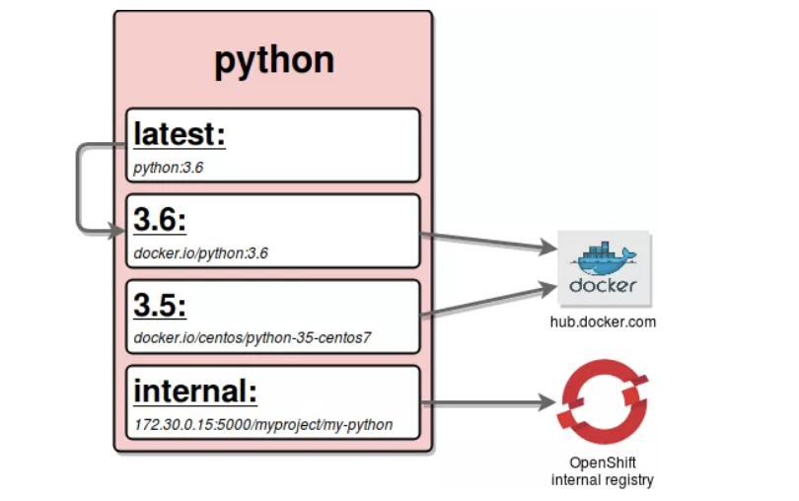
Image Streams
Image Stream example
An image stream represents one or more Docker images identified by tags.
Presents a single virtual view of related images
Can refer to images from any of the following:
Its own image repository in OpenShift’s integrated Docker Registry
Other image streams
Docker image repositories from external registries
Image Streams are trigger an event when underlying image is changed (even if tag remains the same)
Graphic source: https://blog.openshift.com/image-streams-faq/
Notes:
Example Image Stream referencing a Python image
Tags 3.5 and 3.6 reference images at Docker Hub
Tag internal references an image in the internal Open Shift registry
Tag latest refers to the Image Stream tag 3.6

Slide 24
Level 1: Builds
Defined via a BuildConfig object
A blueprint for a process to transform base images + source code, app binaries, or Dockerfiles to an app image:
Key attributes:
Input (input to the build process ) - e.g. file, directory, GH repo etc
Strategy (how to build the app image)
Options:
S2I – Use a specialized builder image to generate app image (more later)
Docker - Use a Docker file to generate app image
Pipeline - A Jenkins pipeline that generates the app image from source
Custom – Encapsulate your build process via a custom builder image
Output (result of the build process) – typically an ImageStream tag

Slide 25


Level 2: Images
Defined via an ImageStream object
An abstraction for working with Docker images inside OpenShift
Key attributes:
ImageStreamImage (reference to actual image) - typically not used directly
ImageStreamTag (reference to a given ImageStream and tag)
Key: ImageStreamImage
ImageStreamTag

Slide 26
Level 3: Deployments
Defined via a DeploymentConfig object
Encapsulates the K8s Deployment and adds deployment strategies and triggers
Key attributes:
Strategy (how to deploy if the underlying Deployment is already deployed)
Options:
Recreate– Blow away old deployment first and then deploy new one
Rolling (default) – Zero downtime rollout via K8s RollingUpdate
Advanced - (Note: require routes)
Blue-Green - running 2 versions of the deployment at the same time and moving traffic from the in-production version (the green version) to the newer version (the blue version).
A/B – partitioning requests between 2 versions of the deployment at the same time and observing the behavior
Triggers (define conditions under which the deployment is automatically triggered)
e.g Input image updated, config changes

Slide 27
Level 4: Abstractions
Defines all of the additional resources needed for an app like networking, storage, security etc
Frequently used resources: (there are several others)
Service – Internal load balancer and router. Directs network traffic to replicated Pods
Route – Exposes a Service at a defined host name to allow access from external traffic
Persistent Volume Claim – Permanent storage used by apps to persist data after the app has stopped running
Secret – Mechanism for holding sensitive data. Decouples sensitive data from the the Pods that use them.

Slide 28
S2I provides a repeatable method to generate application images from source/binary code

Slide 29
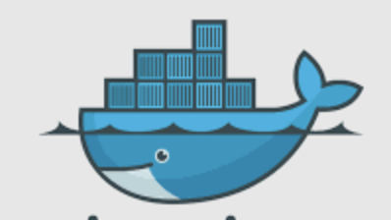
S2I Overview
Layer 4: Abstractions
S2I is a tool that merges source code or binary into an application specific image
Uses a builder image
OpenShift provides multiple builder images
e.g. Node.js, Java
Can create and add your own
Layer 3: Deployments
Layer 2: Images
App Image
Layer 1: Builds
S2I
Layer 0: Base images
Builder Image

Slide 30
Anatomy of an S2I Builder Image
Docker file contains S2I specific labels and env vars | LABEL io.openshift.s2i.scripts-url=image:///usr/local/s2i \ io.s2i.scripts-url=image:///usr/local/s2i \ io.k8s.description=” S2I for Open Liberty Profile" \ io.k8s.display-name="Liberty 19.0.0.4 javaProfile7" \ io.openshift.expose-services="9080/tcp:http" \ io.openshift.tags="runner, builder,liberty" \ io.openshift.s2i.destination="/tmp" ENV STI_SCRIPTS_PATH="/usr/local/s2i" \ S2I_DESTINATION="/tmp"
Provides base image for applications generated from the S2I image | # This S2I image provides a base for building and # running WebSphere Liberty applications. FROM websphere-liberty:javaee7
A series of scripts | assemble – Compiles and/or assembles app components from input (required) run – Command to run generated app image (required) usage – Outputs usage info about the generated image (optional) save-artifacts – Saves artifacts to support incremental builds (optional)

Slide 31
Templates provide a parameterized set of objects that can be processed by OpenShift

Slide 32
Templates Overview
Templated objects
Layer 4: Abstractions
Routes, Services etc
Templates typically contain parameterized objects for the various layers of the deployment process for an app or service
Once created they are tightly integrated with the Web console and CLI
Simplifies the deployment of apps or services that require several objects to be created
OpenShift includes several templates that can be used OOTB
e.g. Jenkins, MariaDB etc
Layer 3: Deployments
DeploymentConfig
Layer 2: Images
ImageStream
Layer 1: Builds
BuildConfig
Layer 0: Base images

Slide 33
Anatomy of a Template
Metadata with name, description | apiVersion: v1 kind: Template metadata: name: pbw-liberty annotations: openshift.io/display-name: Plants by WebSphere on Liberty w/MariaDB description: Plants by WebSphere on Liberty App using MariaDB as the database tags: liberty,websphere iconClass: icon-liberty openshift.io/provider-display-name: IBM Client Dev Advocacy. openshift.io/documentation-url: https://github.com/djccarew/app-modernization-plants-by-websphere-jee6.git openshift.io/support-url: https://developer.ibm.com
Parameters | parameters: - name: APPLICATION_NAME displayName: Application name description: The name for the application. value: pbw-liberty-mariadb required: true …
Parameterized objects | - apiVersion: image.openshift.io/v1 kind: ImageStream metadata: name: "${APPLICATION_NAME}" …

Slide 34
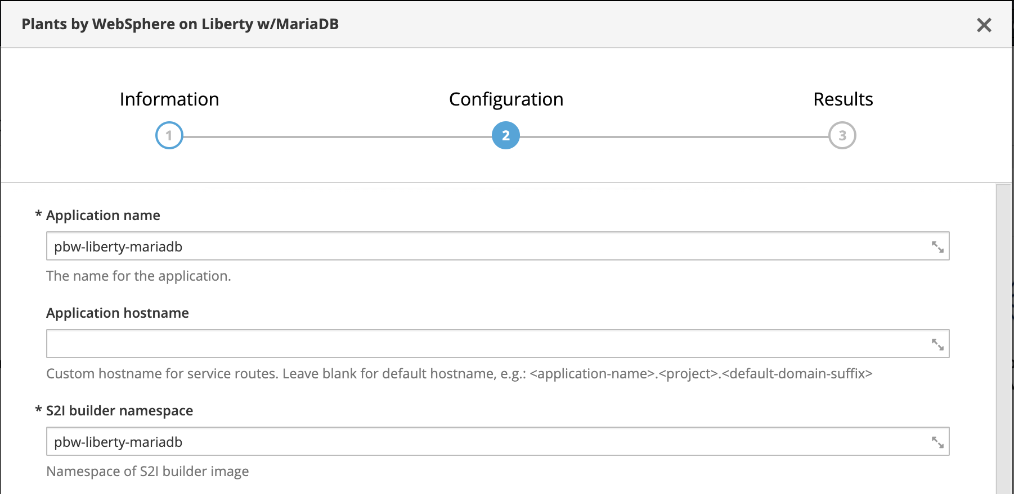
Using a template
From Web console
1 .Select template
From CLI
Apply template and specify parameters by running oc process and then piping the result to oc create
$ oc process –f pbw-liberty \
-p APPLICATION_HOSTNAME=foobar.com \
| oc create -f -
2. Apply parameters

Slide 35
Resources
S2I
https://docs.openshift.com/container-platform/3.11/creating_images/s2i.html
OpenShift Templates
https://docs.openshift.com/container-platform/3.11/dev_guide/templates.html

